Slide 1
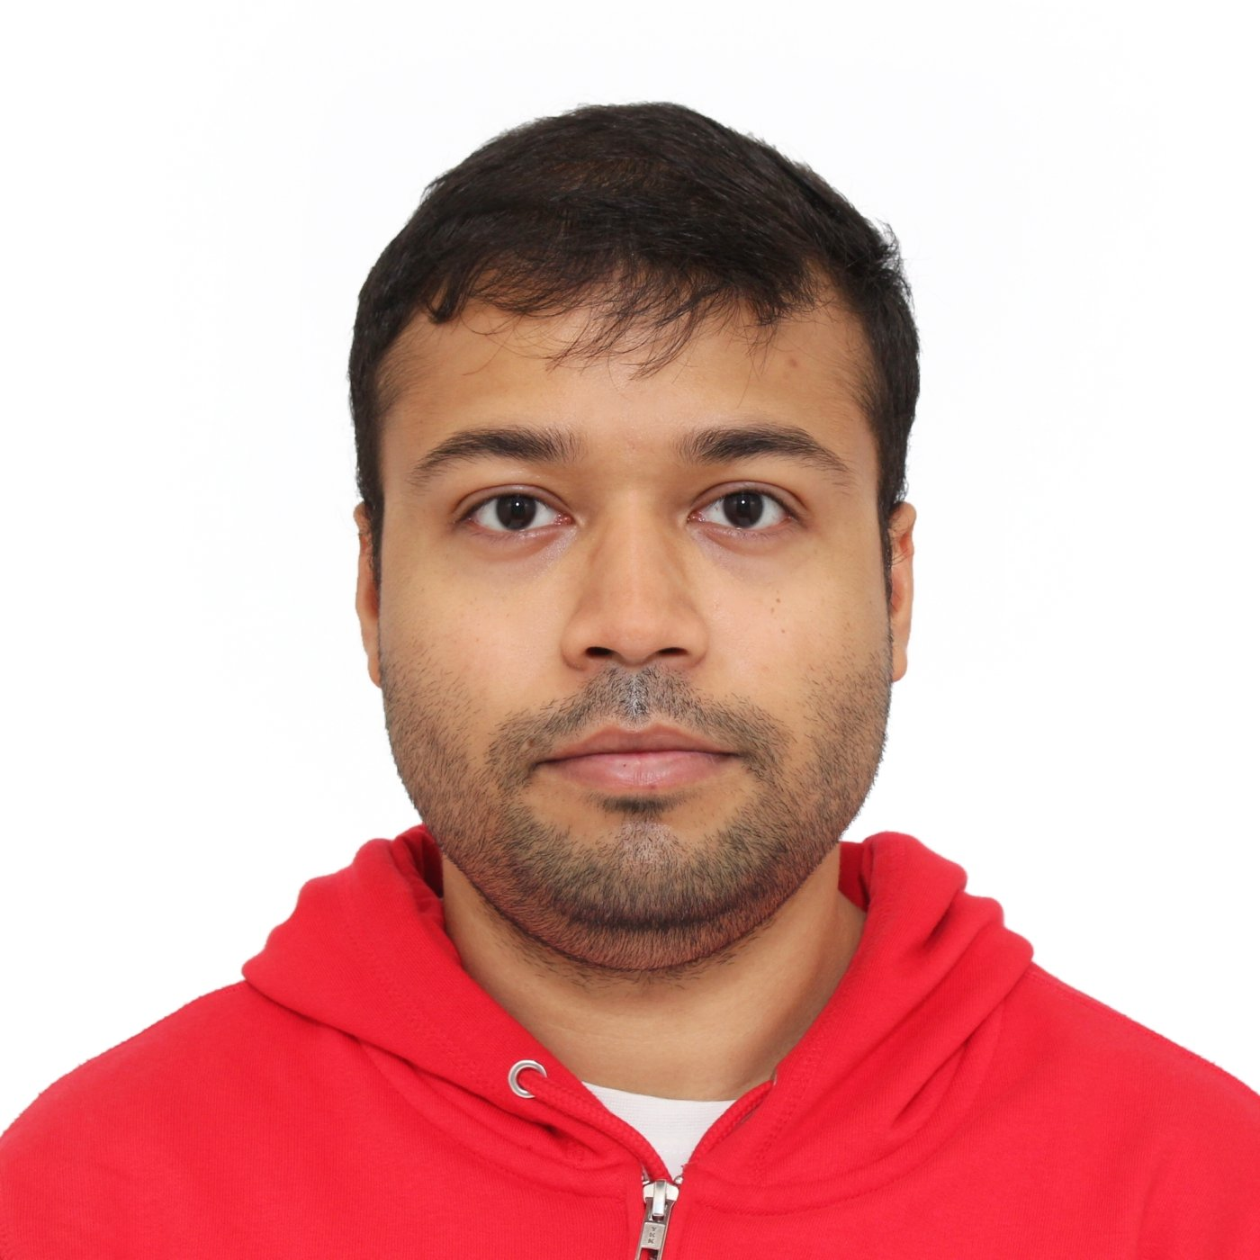



Arnab Ghosh
PhD student
EXPERIENCE
May 2019
― Present
PhD in Applied Physics/Software Developer
EINDHOVEN UNIVERSITY OF TECHNOLOGY
Understanding the effects of solid particles on the physics of liquid jetting in light of inkjet printing technology using numerical methods (Lattice Boltzmann Method)
Collaborated with the Physics of Fluid group at Twente University for experimental data on the phenomenon of particle dynamics in liquid jetting
Developer and maintainer of in-house code LBE3D for solving fully resolved particles in complex fluid flow problem with multiphase in 3D using C Language on Linux and MacOS
Maintained a Git repository through the utilisation of CI/CD pipelines
Analysis and visualisation of large datasets using ParaView, Matplotlib/Python, and Gnuplot
Documentation of developer issues using Markdown and LaTeX
Submitted and published papers in peer-reviewed journals on modelling, simulation and fluid physics
About me
A passionate PhD student of Applied Physics with experience in programming to solve large scale fluid physics problems, data analysis and visualisation. Possessing youthful exuberance for learning machine learning and actively seeking challenging projects to work on within a team.
July 2016
― June 2018
Mechanical Engineer/Software Developer
Personal
INDIAN INSTITUTE OF TECHNOLOGY GUWAHATI
Arnab Ghosh
nationality: Indian
1993
Developed C code from scratch for simulating in 2D fluid-particle interaction using a coupled Immersed Boundary and Lattice Boltzmann solver
Utilised Tecplot for visualisation and LaTeX for documentation
Made extensive use of Bash and Linux
Areas of specialization
1 week, 2022
JM Burgercentrum course “Fluid problems using Machine Learning”
Engineer ⋅ Physicist
⋅ Programmer
EINDHOVEN UNIVERSITY OF TECHNOLOGY
Solved multiple test cases with different models using Pytorch on Jupyter notebook
Completed assignment tasks based on Kaggle
Competencies
C / Python / Linux
Git / Bash / OpenMPI
SSH-clients / LaTeX
NumPy / Matplotlib Paraview / MS Office
SolidWorks / Ansys Fluent
Jan 2015
― May 2026
Modelling and Structural analysis of a horizontal axis wind turbine blade (Batchelor project)
HERITAGE INSTITUTE OF TECHNOLOGY
Modelled a horizontal axis wind turbine blade using NACA aerofoils on SolidWorks
Analysed fluid flow over the turbine blade using Ansys Fluent
Analysed induced structural stress on the turbine blade with Ansys Mechanical
Interests
Squash, Padel, Cooking, Hiking, Active portfolio management, Stock market and ETFs
DEGREE
@
arnab.sphs12@gmail.com
2019―Present
Ph.D., Applied Physics
☏
+(31) 625252478
2016―2018
EINDHOVEN UNIVERSITY OF TECHNOLOGY, NETHERLANDS
in
Masters in Technology, Mechanical Engineering
arnab-ghosh-522023149
INDIAN INSTITUTE OF TECHNOLOGY GUWAHATI, INDIA
arnab-sphs12
2012―2016
Bachelors in Technology, Mechanical Engineering
Eindhoven, Netherlands
HERITAGE INSTITUTE OF TECHNOLOGY, INDIA

Slide 2
Arnab Ghosh
PhD student
EXPERIENCE
May 2019
― Present
PhD in Applied Physics/Software Developer
EINDHOVEN UNIVERSITY OF TECHNOLOGY
Understanding the effects of solid particles on the physics of liquid jetting in light of inkjet printing technology using numerical methods (Lattice Boltzmann Method)
Collaborated with the Physics of Fluid group at Twente University for experimental data on the phenomenon of particle dynamics in liquid jetting
Developer and maintainer of in-house code LBE3D for solving fully resolved particles in complex fluid flow problem with multiphase in 3D using C Language on Linux and MacOS
Maintained a Git repository through the utilisation of CI/CD pipelines
Analysis and visualisation of large datasets using ParaView, Matplotlib/Python, and Gnuplot
Documentation of developer issues using Markdown and LaTeX
Submitted and published papers in peer-reviewed journals on modelling, simulation and fluid physics
About me
A passionate PhD student of Applied Physics with experience in programming to solve large scale fluid physics problems, data analysis and visualisation. Possessing youthful exuberance for learning machine learning and actively seeking challenging projects to work on within a team.
July 2016
― June 2018
Mechanical Engineer/Software Developer
Areas of specialization
INDIAN INSTITUTE OF TECHNOLOGY GUWAHATI
Engineer ⋅ Physicist
⋅ Programmer
Developed C code from scratch for simulating in 2D fluid-particle interaction using a coupled Immersed Boundary and Lattice Boltzmann solver
Utilised Tecplot for visualisation and LaTeX for documentation
Made extensive use of Bash and Linux
Competencies
C / Python / Linux
Git / Bash / OpenMPI
SSH-clients / LaTeX
NumPy / Matplotlib Paraview / MS Office
SolidWorks / Ansys Fluent
1 week, 2022
JM Burgercentrum course “Fluid problems using Machine Learning”
EINDHOVEN UNIVERSITY OF TECHNOLOGY
Solved multiple test cases with different models using Pytorch on Jupyter notebook
Completed assignment tasks based on Kaggle
Interests
Jan 2015
― May 2026
Modelling and Structural analysis of a horizontal axis wind turbine blade (Batchelor project)
Squash, Padel, Cooking, Hiking, Active portfolio management, Stock market and ETFs
HERITAGE INSTITUTE OF TECHNOLOGY
Modelled a horizontal axis wind turbine blade using NACA aerofoils on SolidWorks
Analysed fluid flow over the turbine blade using Ansys Fluent
Analysed induced structural stress on the turbine blade with Ansys Mechanical
DEGREE
@
arnab.sphs12@gmail.com
2019―Present
Ph.D., Applied Physics
☏
+(31) 625252478
EINDHOVEN UNIVERSITY OF TECHNOLOGY, NETHERLANDS
in
arnab-ghosh-522023149
2016―2018
Masters in Technology, Mechanical Engineering
arnab-sphs12
INDIAN INSTITUTE OF TECHNOLOGY GUWAHATI, INDIA
Eindhoven, Netherlands
2012―2016
Bachelors in Technology, Mechanical Engineering
HERITAGE INSTITUTE OF TECHNOLOGY, INDIA

Slide 3
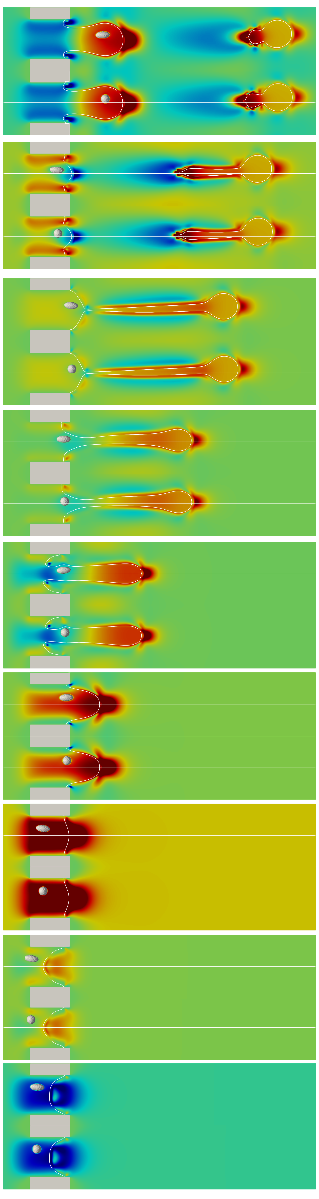
Arnab Ghosh
PhD student
EXPERIENENCE
May 2019
― Present
PhD in Applied Physics/Software Developer
EINDHOVEN UNIVERSITY OF TECHNOLOGY
Understanding the effects of solid particles on the physics of liquid jetting in light of ink-jet printing technology using numerical methods (Lattice Boltzmann Method)
Collaborated with a Physics of Fluid group in Twente University for experimental data on the phenomenon of particle dynamics in liquid jetting
Developed and maintainer of in-house code LBE3D for solving fully resolved particles in complex fluid flow problem in multiphase in 3D using C Language on Linux and MacOS
Maintained Git repository through the utilisation of CI/CD pipelines
Analysis and visualisation of large data sets using ParaView, Matplotlib/Python and Gnuplot
Documentation of developer issues using Markdown and LaTeX
Submitted and published papers in peer-reviewed journals on modelling, simulation and fluid physics
Lectured and supervised Bachelor and Master students on Non-linear Equations, Advanced CFD
About me
A passionate PhD student of Applied Physics with experience in programming to solve large scale fluid physics problems, data analysis and visualisation. Having a youthful exuberance in learning machine learning and looking for challenging projects to
work in a team.
Personal
July 2016
― June 2018
Mechanical Engineer/Software Developer
Arnab Ghosh
nationality: Indian
1993
INDIAN INSTITUTE OF TECHNOLOGY GUWAHATI
Developed C code from scratch for simulating in 2D fluid-particle interaction using a coupled Immersed Boundary and Lattice Boltzmann solver
Visualisation using Tecplot and documentation using LaTeX
Extensive utilisation of Bash and Linux
Areas of specialization
Engineer ⋅ Physicist
⋅ Programmer
1 week, 2022
JM Burgercentrum course “Fluid problems using Machine Learning”
Competencies
EINDHOVEN UNIVERSITY OF TECHNOLOGY
C / Python / Linux
Git / Bash / OpenMPI
SSH-clients / LaTeX
NumPy / Matplotlib Paraview / MS Office
Matlab / Ansys Fluent
Pytorch
Jupyter notebook
Details
Jan 2015
― May 2026
Modelling and Structural analysis of a horizontal axis wind turbine blade (Batchelor project)
HERITAGE INSTITUTE OF TECHNOLOGY
Modelled a horizontal axis wind turbine blade using NACA aerofoils on SolidWorks
Analysed fluid flow over the turbine blade using Ansys Fluent
Analysed induced structural stress of the turbine blade with Ansys Mechanical
Interests
Squash, Padel, Cooking, Hiking, Active portfolio management, Stock market and ETFs
DEGREE
@
arnab.sphs12@gmail.com
2019―Present
Ph.D., Applied Physics
☏
+(31) 625252478
2016―2018
EINDHOVEN UNIVERSITY OF TECHNOLOGY, NETHERLANDS
in
arnab-ghosh-522023149
Masters in Technology, Mechanical Engineering
arnab-sphs12
INDIAN INSTITUTE OF TECHNOLOGY GUWAHATI, INDIA
Eindhoven, Netherlands
2012―2016
Bachelors in Technology, Mechanical Engineering
HERITAGE INSTITUTE OF TECHNOLOGY, INDIA

Slide 4
Arnab Ghosh
PhD student
PROGRAMMING/SOFTWARE
Programming Language
Data analysis
Data Visualisation
Design Software
Documenting/Editing
Operating systems
C, C++*, Python, Bash, Git, MATLAB*, Mathematica*
NumPy, pandas, MS Excel
Matplotlib, ParaView, Tecplot 360, gnuplot
SolidWorks, AutoCAD
LaTeX, Markdown, VS Code, Sublime, MS Office, Emacs
Linux, MacOS, Windows
PRESENTATIONS AND TEACHING
* Elementary proficiency
Delivered my research as talks/posters at multiple international conferences in Netherlands, USA and India (including APS, JMBC, DSFD, FMFP)
Accumulated 300+ hours of teaching experience to Bachelor’s and Master’s students at Eindhoven University of Technology
Conducted 100+ hours of teaching Fluid Mechanics for Master’s and Bachelor’s students at Indian Institute of Technology Guwahati, India
Provided 100+ hours of teaching to underprivileged children in Guwahati, India
Sedimenting flat plate
ACHIEVEMENTS
Secured an All-India Rank of 1010 in the Graduate Aptitude Test in Engineering (GATE) out of 0.2 million candidates
Achieved an All-State Rank of 4038 in West Bengal Joint Entrance Exam (WBJEE) among 0.12 million candidates
Awarded a grant of 49 million computational hours on Snellius as part of a 5-members group
PUBLICATIONS
A. Ghosh, A. Gabbana, H. Wijshoff, and F. Toschi, Effective Force Stabilising Technique for the Immersed Boundary Method, Communications in Computational Physics 33, 349–366 (2023) 🔗 link
A. Ghosh, S. Majumber, G. Natarajan, and D. N. Basu, Comparative Study of Two Immersed Boundary Approaches in the Lattice Boltzmann Framework, Proceedings of the 7th International and 45th National Conference on Fluid Mechanics and Fluid Power (FMFP), (2018) 🔗 link
The list of publications can be found on 🔗 GoogleScholar/ArnabGhosh
Contact information of referees can be provided upon request
LANGUAGE PROFICIENCY
English (TOEFL 109)
Bengali (native)
Hindi (native)
Dutch (A0)
Liquid jetting with fully resolved particles

Slide 5


